Slide 1
PROCESS AND WORKFLOW AUTOMATION
RAHUL BHARDWAJ
RAHUL BHATIA
SAGAR DOSHI
JINESH KACHHARA
DEVANG PAREKH
CHIRAG SACHDEV
RISHABH SRIVASTAVA

Slide 2
INTRODUCTION
What is Process and workflow automation?
Why do we need Process and workflow automation?

Slide 3
Categorization of Processes In An Organization
Material Process
Information Process
Business Process
Notes:
Material Process : These are processes which relate to human tasks that are rooted to physical world
Information Process : these relate to automated tasks , i.e tasks performed by human interacting with computers or these can be totally done by computers.
Business Process : These are market centered descriptions of an organization’s activities , implemented as information process and/or material process.

Slide 4
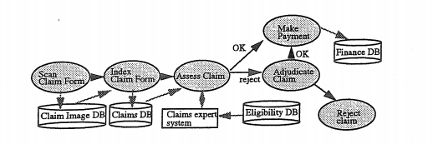
Workflow
Workflow is defined as a collection of tasks organized to accomplish some business process
Notes:
In Health claim workflow , a claim is first manually scanned and stored into an object database. Then claim is manually indexed in a relational database.This information is subsequently analyzed by an eligibility database to determine if payment should be made.If claim is rejected , a claim representative discusses the claim with customer and either agrees to make some payment , or to reject the claim.If payment is made , the make payment take accesses the finance database and the records the payment.

Slide 5
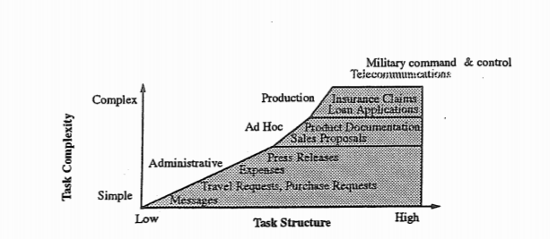
Characterizing Workflows
Ad hoc
Administrative
Production
Notes:
This characterization was first given by McCready.
These are based on :
1 Repetitiveness and predictability of workflows and tasks
2. How the Workflow is Initiated and controlled
3. requirements WFM functionality

Slide 6
Organizational Context and Workflow Specifications
Organizational Context
Hierarchy Structure
Roles
Agents
Security Level
Approval Authorities
Workflow Specifications
Workflow routes
Information
Associations
Events
Rules
Notes:
Organizational Scheme: Hierarchy Structure : Organizational objects and relationships, Who reports to whom.
Roles: A role is a collection of tasks and responsibilities that can be assigned to an agent.
Agents: Human and software agents have capabilities that allow them to play certain roles.
Security Levels : Who can access which data and software and perform which processes.
Approval Authorities : Which roles are authorized to approve which activities , forms , etc .
Process Specification :
Workflow routes : The time precedence of Workflow tasks
Information : Forms , documents , files and database used in the performance of work,
Associations : Agents with roles , roles with tasks , tasks with data and software etc.
Events: Time based occurrence trigger , suspend or terminate workflow activities
Rules : The conditions under which the workflow can start , be processed and terminate; how tasks are assigned to agents.
•BPA tech should support processes in context of total organization, its strategies and people.
•Process Oriented WFMS – sophisticated models, routing and task management facilities.

Slide 7
Workflow Management Systems are designed to make work more efficient, integrate heterogeneous applications systems and support inter-organizational as well as intra-organizational processes in electronic commerce applications. It automates business processes by coordinating and controlling the flow of work and information between participants.
Companies that first implemented WFMS :
IBM, Oracle, HP
Microsoft, SAP, BEA Systems
Successful WFMS deployment results in :
Cycle time reductions
Cost reduction
Improved accuracy
Greater control
Increased work satisfaction
Unsuccessful WFMS deployment results from :
Poor change management
Rigid bureaucratic organizations
Lack of sustained top management support

Slide 8
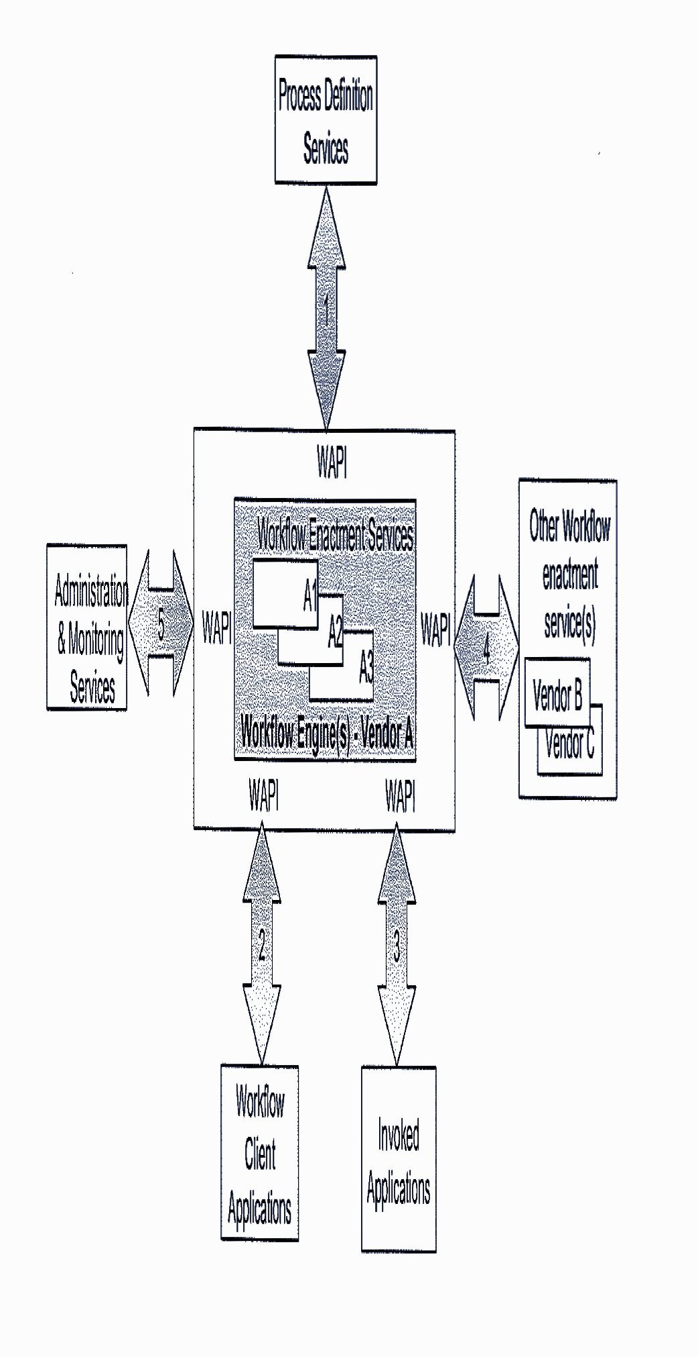
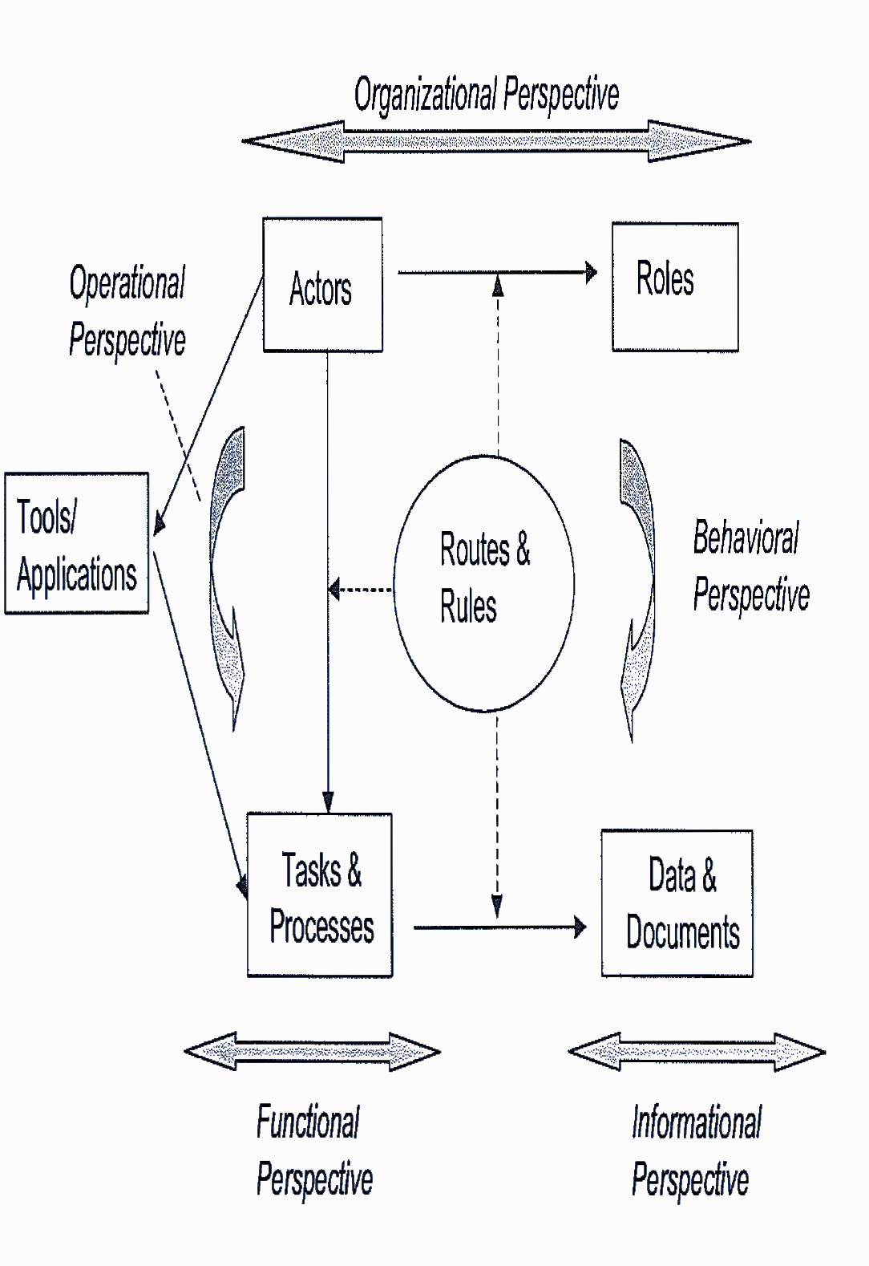
Some Basic terms related with WFMS are :
Business Process
Activity
Worklist
Work Items
Notes:
Business Process - Consists os sequence of activities. Has distinct inputs and outputs and serves a meaningful purpose within and between organizations.
Activity - Discrete process steps performed by machine/human agent and has 1 or more tasks.
Worklist - Set of tasks to be performed by a user in a workflow system. Prepared by WFMS and displayed to user on his/her screen.
Work Items - Individual tasks on a worklist.

Slide 9
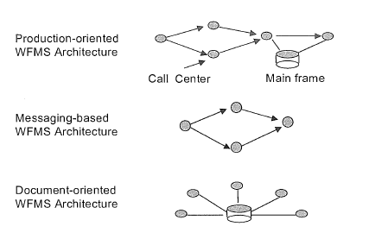
Build Tools :
Analytical tools like Petri Nets formally analyze workflow processes for correctness and consistency.
IBM’s MQSeries Workflow provide scripting language to support definition of processes, activities, organization structure and date entry forms.
Lotus Notes is a scripting language to develop workflow system.
WFMS Basic Architectures :
Notes:
Production Architecture supports complex workflows and communicates with corporate databases, mainframe systems etc.
Messaging WFMS Architecture supports less demanding throughput requirements and often implemented by adding workflow features.
Document centric Architecture adds workflow capabilities to document management systems.

Slide 10
Workflow automation by improving knowledge work process
What is knowledge?
What is knowledge work process?
Process approach
Notes:
To understand this first let us see what is knowledge: Knowledge are formal facts, rules, policies or procedures.
Knowledge work processes includes activities such as research and product development, advertising, education, professional services like law, accounting, consulting.
The process approach allows an end to end view of how best to structure, sequence and measure work activities to reach targeted outcomes. The process approach promotes an examination of what, how things are done from a viewpoint of producing value for a customer.

Slide 11
Approach to improve knowledge work
Finding existing knowledge
Creating new knowledge
Knowledge packaging
Use of existing knowledge
Reuse of knowledge
Notes:
1. Finding existing knowledge: Understanding knowledge requirements, searching for it among multiple sources and passing it along to the requester or user. Eg: Insurance company.
2. Creating new knowledge: eg: Research activities in pharmaceutical firms.
3. Knowledge packaging: Publishing is a prime example of knowledge packaging.
4. Use of existing knowledge: eg: a physician is normally expected to experiment on a patient to create new knowledge but rather to apply existing medical knowledge. (by applying existing medical knowledge, a physician is expected to cure a patient and create new knowledge of experience)
5. Reuse of knowledge: eg: product development process, in which engineers were encouraged to reuse existing components in software development process. Using object oriented technology.
Example of product development organization.
Separate information distribution from approval.
Process improvement consists of eliminating outputs that customer no longer deemed useful or worth the cost.
The improvement depends on orientation of work, culture, risk of project etc.

Slide 12
Knowledge improvement methods and approaches
Laissez-faire | Reengineering
Characterized as finding good knowledge workers and leaving them to their own devices, only to measure how quickly and how well they produce outputs. | Change how knowledge workers do their work through the redesign of day to day activity.
Eg: Pharmaceutical scientist who experiments with new compounds in the lab for years before identifying a specific drug. | Firms decompose work activities into micro level steps. They assess performance on a daily or even hourly basis.
Here the unit being evaluated is the individual rather than the larger organizational unit. | Here the individual’s identity is subsumed within a larger group.
Fear of change not assumed | Fear of change on the part of workers
Longer to implement | Less time to implement
Lower risk of obvious failure | Visibly risky
Less expensive | More expensive
Notes:
The framework proposed by us is an example of reengineering

Slide 13
Examples on knowledge work process
Companies often want to make knowledge more portable, modular, accessible and recordable; they attempt to make knowledge easier to manage as a discrete object.
A large utility company adopted a similar but more automated approach to knowledge capture and storage.
Notes:
Eg: Stored electronically, different authors idea modules can be combined and recombined in customized configurations, enabling college professors, for eg, to construct a text book to precisely meet their course requirements. The same content can also be used across multiple media, eg, magazine, article, book, online database and CD-ROM. Making the unit of knowledge smaller, it can be reused and leveraged to a much greater degree.
It undertook a project to capture the knowledge of its managers, financial analysts and engineers about how to analyze, implement and manage capital projects. The projects ultimate goal was to create a computer-based expert system; in the short run, the knowledge was captured in a series of documents. The company wanted not only to streamline its own activities when facing a capital project but also to sell this knowledge to other utilities facing similar situations.

Slide 14
IBM’s ASSET WEB and its Impacts.
It is a Strategic Knowledge and Asset Management Collaboration System used by IBM’s Global Services.
It was designed to handle the following technical issues.
Making Knowledge Visible.
Building Knowledge Intensity.
Building the Knowledge Infrastructure.
Developing a Knowledge Culture
It supports the following Business Innovations features.
Organizational and people support.
Asset Managment Process
Managing the whole spectrum Intellectual Capital.
Issue based structure collaboration .

Slide 15
Impacts of ICM Assetweb
Dollar benefits from savings increased $27 million in 1997.
Increased Win rate from 50% to 90% through reuse of Intellectual Capital.
Reduced time spent in preparing proposals by 50 %.
Significant reduction of costs of executing engagements by reusing deliverables and tools provided in assetweb.
Saves one month per year on a typical year long engagement.
Developed 3 qualified prospects per week vs 1 every 2 weeks without reusable IC.
Increased client satisfaction due to high engagement with clients.

Slide 16
Process Automation in Office
It deals with automation of procedural work at offices.
Here it deals with workflow automation of the system in order to enhance the performance and efficiency of the system.
There are two ways of Automation
Traditional approach :
It includes involvement of employee with automation
b) Alternative approach :
It emphasis on complete automation.

Slide 17
Disadvantage of manual workflow
While designing the system the designer does not focus on actual action plan of the procedure, loss of information
Leads to degradation of system performance and efficiency.
Problem:
Due to manual workflow there are chances of data loss and inadequate delivery of information.
Workflow automation helps in improving the overall performance by reduction of data loss and automatic workflow functioning.
Eg. Invoice of delivery
s

Slide 18
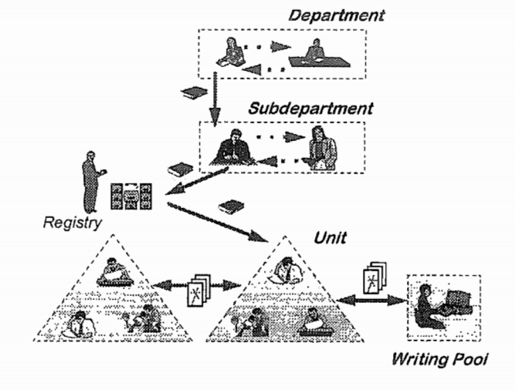
Workflows in Ministerial environment
Application Scenario :

Slide 19
Application
Requirements
Solutions and Experiences
Circulation folders
Digital Signatures
Solution :
Integration of paper documents
Video conference integration

Slide 20
Transforming work
Businesses usually undergoes transformation or implement changes in the organization to overcome certain problems and drawbacks.
To achieve this stage they go through a process called as Business Process Reengineering(BPR).
Here the organization looks on various aspects and areas where they need to focus to implement the change within the organization.
For this they have three steps which the follow which are as follows :

Slide 21
Steps
Collaborate :
Add up the various experiences and observations they got and undergo requirement gathering process to develop it in a more better way
Learn :
Learning about what change can be implemented by looking through the various feedback and observations.
Design :
After learning the things to be implemented then comes the final step of designing the system which will bring the change within the organization.

Slide 22
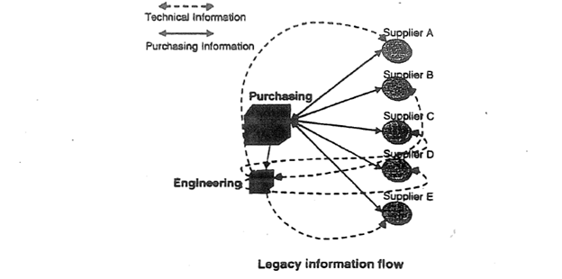
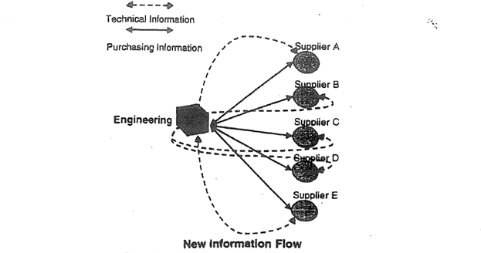
Information Workflow (Lawrence Livermore National Laboratories)
THEN NOW

Slide 23
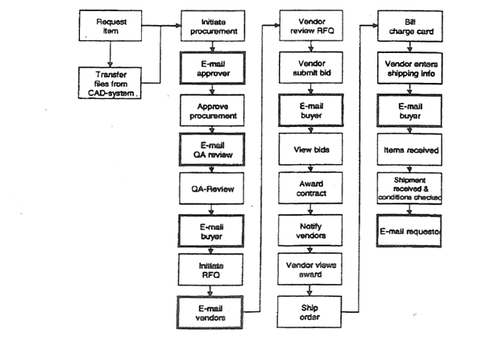
Zephyr’s E-mail Driven Workflow Process

Slide 24
Scenario for workflow automation
India Retail companies have a huge task of tracking goods to various super Markets and Hyper Markets, the process is completely manual as sales representatives have to visit each individual stores, track products via bar code scanners, take surveys in their questionnaires, do shelf checks for the products that are displayed, once the work in their visits is done they have to update their CRM systems with the orders taken, and do the entire process all over again for the next Store.
The disadvantage of this process is that this is very time consuming, lack of efficiency and chances of Data loss is more as the orders are is in bulk and chances of data loss increases. Salesperson has to visit multiple stores the chances of data redundancy increases.

Slide 25
Framework Modelling
Requirement Gathering
Interviewing People
Modeling
Defining Business Rules
Implementation
Notes:
Requirement gathering : We will understand the current business scenario , and identify the problem statement
Interviewing People : We will interview workers about their jobs and daily tasks performed by them.
Modeling : After the key players are identified , and process is identified , Workflow agents tasks, security level and Approval Authorities are identified.
Business Rules : Business rules are formed over the workflow process , for transitions between different actors
Implementation : The System is designed , applying the workflow routes, Information , Events and Association and rules.

Slide 26
Proposed Implementation
Change Management
Retailer 1
CRM
Retailer 2
iPad
Middleware Cloud
Retailer 3
ERP
Retailer n
Reporting / Risk Analysis
Notes:
Retailers: Hypermarkets and SuperMarkets
Sales Officer: An Actor who would visit retail shops and collect orders, Surveys, Shelf Checks, and carry out business processes.
iPad: ipad will have the application which would collect all the surveys, check products via inbuilt barcode scanner, take photographs from the shelfs, and all the business processes.
MiddleWare Cloud: will be a temporary storage for the data that would be received from the iPad’s, and a job would run which would sync the data to the respective Back End systems.
CRM: Customer Relations Management will have an Admin which would assign products and customer to respective Sales officers
ERP: Enterprise Resource Planning has all the products and customer data.

Slide 27
Previously
Pool of Retailers
Marketing and sales executive
Notes:
Previously: Sales Officers had to manually do the data entry and were restricted to a small territory, and the time taken to complete these visits was huge.

Slide 28
Now
Pool of Retailers
Marketing and sales executive
Notes:
Now: now with the process automatized the sales officer would take less time to complete their respective territory and cn cover a bigger ground. Once there visits for the day are complete they can connect to a good wifi network and sync all their data with the BackEnd systems to commit the changes.

Slide 29
EVALUATION/RESULT
Time of execution will be reduced,
Orders can be taken in bulk with proper tracking
Chances of Data loss will be reduced.
Future trends and profits will be predicted.

Slide 30
SUMMARY
This automation will make our life easy but will this lead to Unemployment / Acceptance challenges ???
Notes:
Business Process Automation Dilemma
The vision of workflow proponents, in which almost all work is communicated and executed electronically, promises great benefits in the form of reduced cost and cycle times, and increases processing accuracy. On the other hand it raises issues concerning acceptance by users, adaptability to change organizational needs, excessive control by the management, and the need to provide a work environment that nurtures human energy, initiative and creativity. Using these systems, we can direct automate and monitor work as never before. however going too deep into this new form of “Scientific Management”, we are likely to run into trouble.
We call this potential clash of “Business Process Automation Dilemma”

Slide 31
RESEARCH PAPERS
An Overview of Workflow Management
Building an Internet Based Workflow Based Workflow System
Business Process Integration in Virtual Enterprise
IBM ICM AssetWeb
Improving Knowledge Work Process
Kraft Foods Account Oayable Workflow and Imaging Project
Office Procedure as Practical Action
Support for Workflows in a Ministerial Environment
The Business Process Automation Dilemma
Transforming Work
Workflow Automation Overview and Research Issues
Workflow Based Controlling

Slide 32
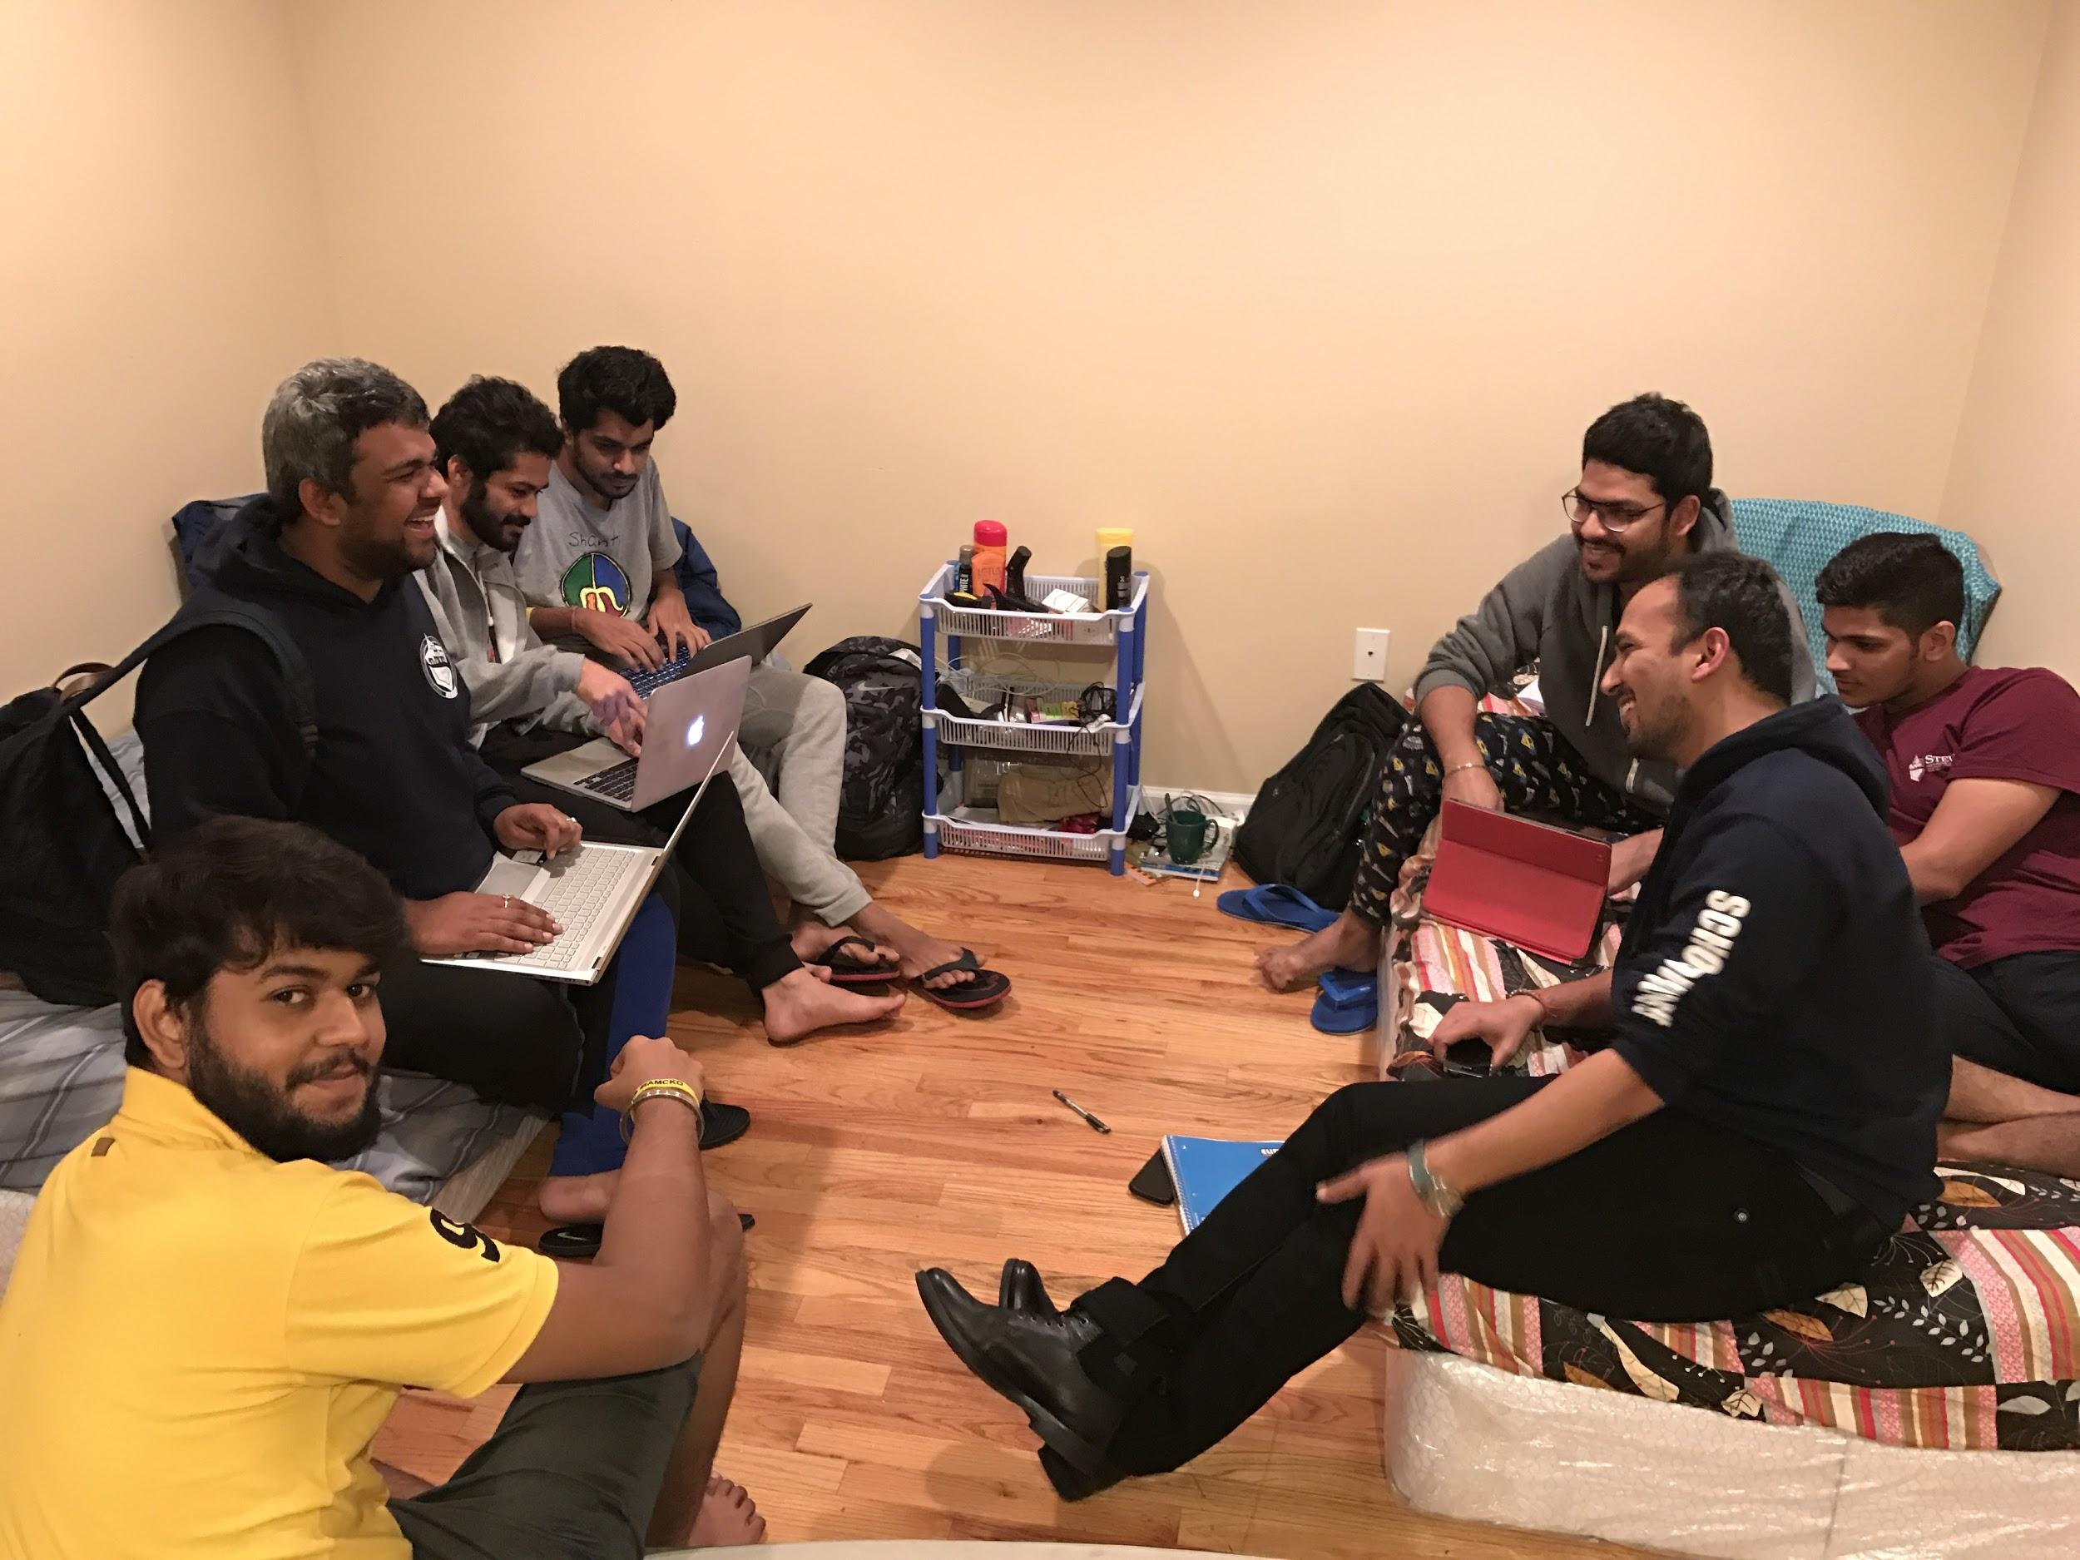
THANK YOU

